Slide 1
Olist E-Commerce Analysis Presentation
By Rawan Muhammed

Slide 2
Project analysis slide 2
Project Analysis
CUSTOMERS
ORDER REVIEWS
ORDERS
PRODUCTS
Database Tables
ORDER ITEMS
SELLERS
ORDER PAYMENTS
GEOLOCATION

Slide 3
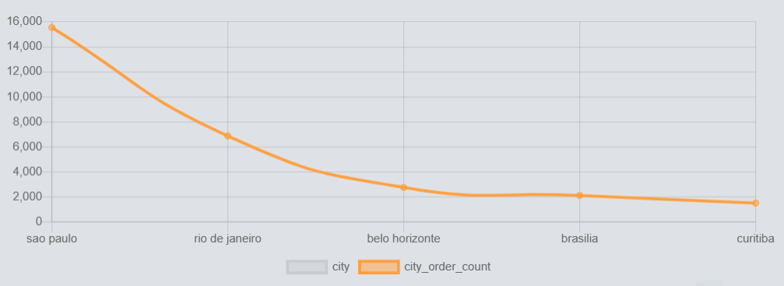
Project analysis slide 5
Project Analysis
What Are The Top 5 Cities By The Number Of Orders Placed?
The Top 5 Cities By The Number Of Orders Placed
Stock warehouses near high-order cities to reduce delivery times and boost customer satisfaction.
Target marketing by focusing on cities with the most orders.

Slide 4
Project analysis slide 4
Project Analysis
What Are The Minimum, Maximum And Average Total Order Prices?
Order prices show the range customers are willing to pay.
9.59
Minimum
Total Order Prices
160.58
Average
Adjust pricing, create tiers, or offer discounts to optimize sales and profits.
13664.88
Maximum

Slide 5
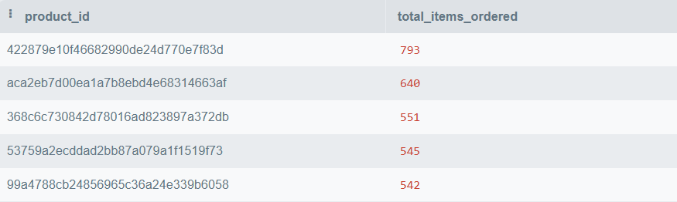
Project analysis slide 6
Project Analysis
What Are The Top 5 Products Based On The Total Number Of Items Ordered?
The top 5 products based on the total number of items ordered
Optimize pricing to maximize profitability while maintaining high sales volumes.
We focus marketing on popular products to attract more customers.

Slide 6
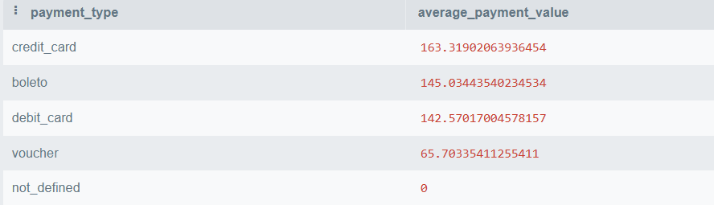
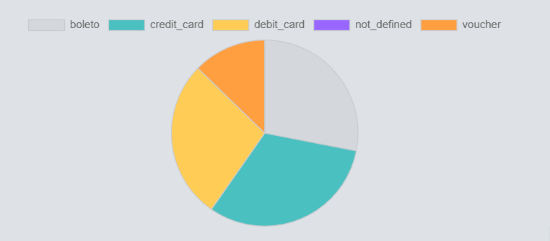
Project analysis slide 6
Project Analysis
What is The average payment value for each payment type?
Encourage these payment methods with exclusive deals to boost revenue.
The average payment value for each payment type
Segment by payment preference and use targeted marketing to boost engagement.
Partner for benefits like lower fees or promo support on high-value payments.

Slide 7
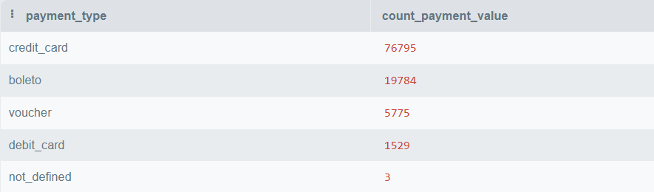
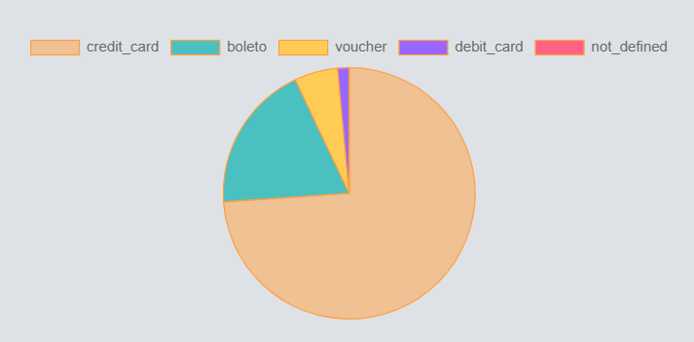
Project analysis slide 10
Project Analysis
What is The count of each payment type?
Payment type counts reveal preferences and help optimize checkout, manage costs, and improve satisfaction. This data supports marketing, resource allocation, and growth strategies.
The count of each payment type
Create risk management strategies and contingency plans for disruptions in high-usage payment methods.

Slide 8
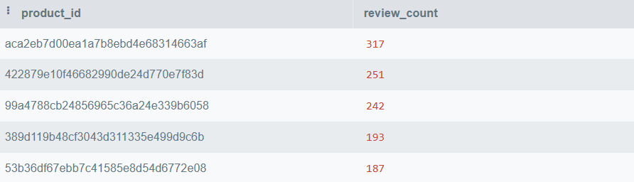
Project analysis slide 5
Project Analysis
What Are Most Reviewed Products?
Most Reviewed Products
Feature popular products with high reviews in marketing to attract more customers.
Use reviews to enhance product development, quality, and address issues.
Ensure popular, well-reviewed products are well-stocked to meet demand and avoid stockouts.

Slide 9
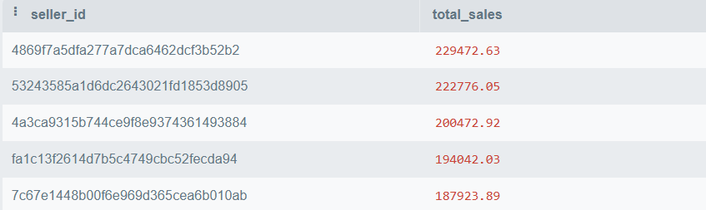
Project analysis slide 3
Project Analysis
Who are The top 5 sellers based on their total sales?
This helps allocate more resources to top sellers, boosting their performance and ensuring they feel supported.
Use this info to set targets for other sellers and share best practices across the network.
The top 5 sellers based on their total sales.

Slide 10
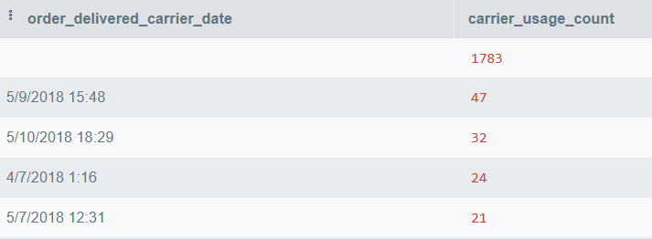
Project analysis slide 3
Project Analysis
How Frequently Orders Were Delivered On Specific Dates?
We can identify high-demand delivery days, aiding in resource planning and operational efficiency.
Also, High delivery volumes on specific days might indicate opportunities for negotiating better rates with carriers or optimizing delivery routes to reduce costs.
The Top 5 dates with the highest number of orders delivered by carriers

Slide 11
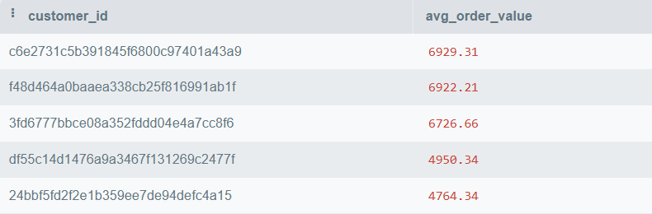
Project analysis slide 5
Project Analysis
Which customers have the highest average order value?
Customers who have the highest average order value?
This identifies customers with the highest average order value, which is useful for businesses aiming to maximize revenue from high-value customers.
These customers may be targeted with special offers, loyalty programs, or personalized services to encourage further spending.

Slide 12
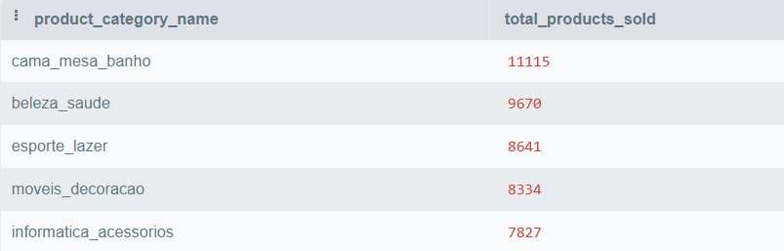
Project analysis slide 3
Project Analysis
What is the total number of products sold in each product category?
This shows the total number of products sold in each category. By identifying the most popular categories, businesses can better manage their inventory
This also helps in forecasting demand and adjusting product offerings accordingly.
The total number of products sold in each product category

Slide 13
Thank You

